Slide 1


Rx.AI
Smarter Prescriptions
using AI
APES

Slide 2
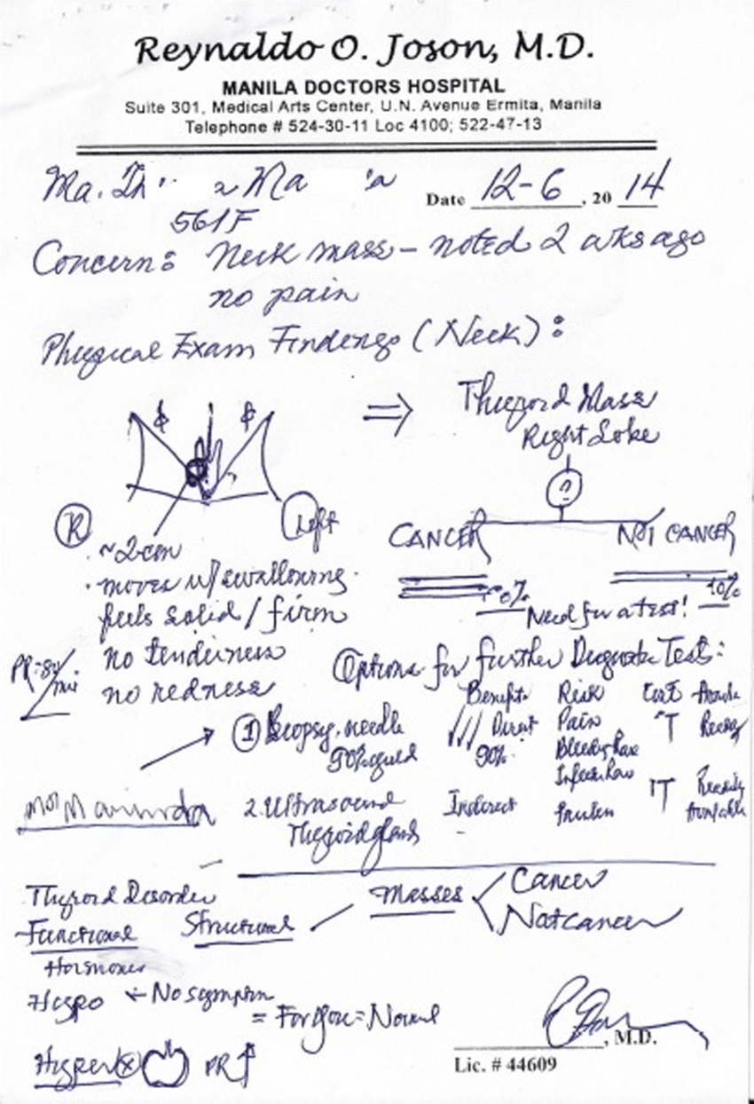
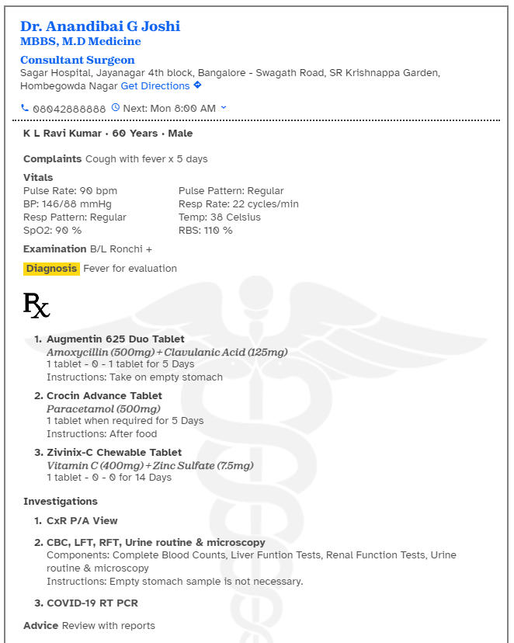

Digitised Prescriptions
—>
Notes:
When technology was asked to solve the prescription problem, our industry came with digitalisation of prescriptions. Which definitely solves the big problem of accurate and clear prescriptions.
But this is just the tip of the iceberg When we talked to patients, mixed our experiences and talk few advices from the doctors, we found out genuine need of smart prescriptions from these digitized prescriptions. Like when a doctor is new to a patient, he has to spend a good amount just understanding the patient history
A patient gets lost in the ocean of his own medical history & medical jargons

Slide 3

Going Beyond Digitised Prescriptions
Hi Shivam, My New Patient
Hi Dr Nikhil,

Slide 4
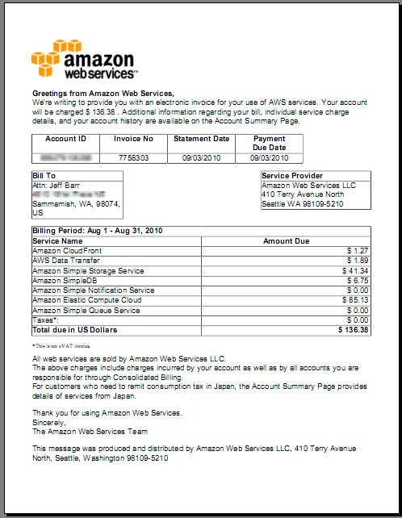

Going Beyond Digitised Prescriptions
Oh Nooo, Shivam has a long medical history Is there a way to get insights on patient’s medical past?

Slide 5
Going Beyond Digitised Prescriptions
Is there a way to just get the relevant prescriptions from this pile of prescriptions?

Slide 6
Going Beyond Digitised Prescriptions
Is there a way to just create prescriptions with ease?

Slide 7
Going Beyond Digitised Prescriptions
How to create personalised Prescriptions?

Slide 8
Rx.AI for Doctors
Demo Time!

Slide 9


Rx.AI for Doctors
Patient Profiler
Prescription Organiser
Voice Assisted Prescription Maker
Doctor Happy
Notes:
A user comes to visit doctor, But the doctor gets stuck because it’s hundreds of prescription that this patient has
The doctor using out Rx.AI Patient Profiler, The doctor can get insights of our patient’s past medical history (no more going through 100s of patient prescriptions). This is our first model which analyses the whole prescription patients and provides prec
Now since this patient is this time here to get his Asthama threated, The doctor needs more insights on his particular disease like Ashtama or we can say the patient needs to provide this info from a long list of prescriptions. This is again a daily problem faced by both medical profressionals and patients where they struggle in finding relevant prescriptions . We our Rx.AI prescriptions organiser, we can filter prescriptions using Hospitals, Doctors & Diagnosis like here the doctor selects Asthama.
Volla, All Asthama related prescriptions are right in front of u. The doctor can view them and get the relevant information.
Now, Now as our doctor has complete understanding of the patient’s related issues, let him create a new prescription
Here we have given our busy doctors 2 options: manual way using form filling or a audio tool. Where all he needs to do it to say the medicines and let AI do the writing for him. (it’s like a Rx.AI Prescription Creation Voice Assistant)
In medicine, there are 3 most important things: Right medicines,Quantity & Timing
Our next AI module targets just that, Our module creates notifications for the patients and tracks his usage on it. This data is presented during patient profile analysis.
Now, let’s come to the patient side:
We were able to organise prescriptions of the patient already, now let’s see how we can make this plain page for patients, smarter
I as a patient has zero understanding of prescription jargons, I need more insights, on medicine insights. Here u go, patient gets medicine context (usage), generica medicine salts, alertnative medicines if they are cheaper as everyone cannot afford branded medicines
The patient can get a personalised lifestyle plan which includes a workout and diet plan
I think here we have given a genuine try on giving patients freedom of choice to choose meds & economics that work for them. The patient has freedom to get lifestyle plan that works for his complete prescription history by taking not just his current but earlier medical hisotry also.
In total of 7 AI modules have enabled us to target one of the major pain points,

Slide 10
Patient’s Dilemma
I can’t find my prescriptions on time
Patient Shivam

Slide 11
Patient’s Dilemma
I can’t find my prescriptions on time
I want lifestyle advices
Patient Shivam

Slide 12
Patient’s Dilemma
I can’t find my prescriptions on time
I want lifestyle advices
I want to understand & get affordable treatment
Patient Shivam

Slide 13
Patient’s Dilemma
I can’t find my prescriptions on time
I want lifestyle advices
I want to understand & get affordable treatment
I want to know which doctor I should reach out to
Patient Shivam

Slide 14
Rx.AI for Patients
Demo Time!

Slide 15
Rx.AI for Patients
Prescription Organiser
Diet & Workout Planner
Patient Profiler
Affordable & Understandable Prescription
Doctor Recommendations
Patient Shivam

Slide 16
Solution Summary
Build 9+ AI Widgets to Solve Prescription Management, Patient Analysis, Prescription Analysis, Prescription Creation, Lifestyle Recommendations, Generic Medicines suggestions, Medicine Insights, Finding Doctor etc. Developed Reusable Modules/Boiler Plates for Document Organiser, Insights Creation, Audio to text etc.

Slide 17

Team Behind
APES
Akaspreet
Shivam
Shivam Yadav Prakhar Atre
Ashish Agarwal Mayank Soni

